Slide 1


Titolo presentazione sottotitolo
MyTaxiService
Milano, XX mese 20XX
Requirement Analysis and Specification Document

Slide 2
Introduction
The government of a large city wants to optimize its taxi service.
The aim of the project is to create a brand new taxi application that is
used by both the taxi drivers and the passengers to access the taxi service.
Passengers can request or reserve a taxi through a web or a mobile application.
Taxi drivers can access the service only from mobile application.
They can manage their availability and ride requests that they receive from the system.
The system has the city map divided into areas and holds a taxi queue in each area. It manages the taxis in queue based on their availability and what kind of answer they give to a given request.

Slide 3
Actors
Guest:
Request a taxi: requires personal information
Register
Registered Passenger:
Login
Request a taxi: no extra information needed
Reserve a taxi: origin and destination, has to be made at least 2 hour before the desired time
Taxi Drivers:
Give/Revoke availability
Accept/Refuse requests

Slide 4
Goals
• Permit a guest to register to the service.
• Permit a guest to request a taxi.
• Permit a guest to sign in and become a registered passenger
• Permit a registered passenger to require a taxi.
• Permit a registered passenger to make a reservation.
• Permit a registered passenger to cancel a reservation.
• Permit a taxi driver to give the system his availability.
• Permit a taxi driver to revoke his availability.
• Permit a taxi driver to accept a ride request.
• Permit a taxi driver to refuse a ride request

Slide 5
Assumptions and Dependencies
• There is not an administrator or a privileged user. We think that a
hierarchy of users is not necessary to keep the system safe;
• Guest user is identified through his public IP address;
• The position of the user can always be determined, via browser or GPS
(see HTML5 Geolocation), and has a good approximation. Otherwise
the service will not be accessible;
• A taxi driver can access the service only if he is signed up. The registration is made directly by the taxi provider, therefore taxi drivers
will simply have to sign in in order to access the service. The taxi
provider assigns an ID number to taxis.
• Through the ID number of a taxi it is possible to retrieve some informations (like the location) of the taxi itself;

Slide 6
Assumption and Dependencies
• If a taxi driver does not accept a call within 1 minute after the notification, a rejection will be automatically recorded in the database and
the request will be forwarded to another taxi;
• After 3 consecutive rejections (voluntary or involuntary) the taxi avail-
ability will be revoked automatically;
• After a request, a user (registered or guest) can not make other re-
quests in the next 30 minutes;
• Reservations must be taken at least 2 hours in advance from the time
of taxi request, otherwise the reservation will not be accepted;
• Reservations must have 30 minutes of distance between them, otherwise they will not be accepted
• A user that registered a reservation for a taxi can not make requests
within 30 minutes before the reservation;

Slide 7
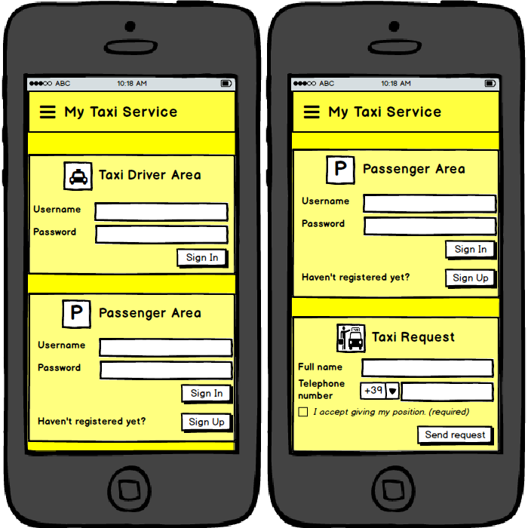
Mockup

Slide 8
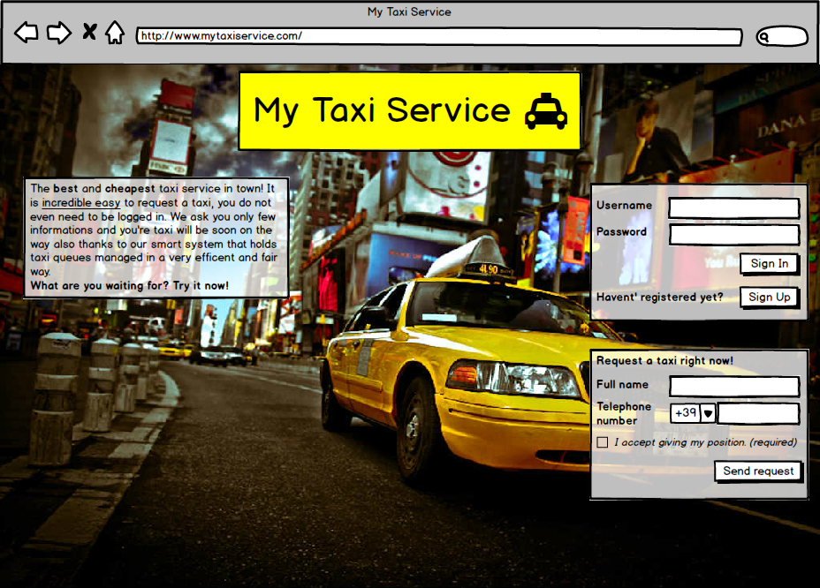
Mockup

Slide 9
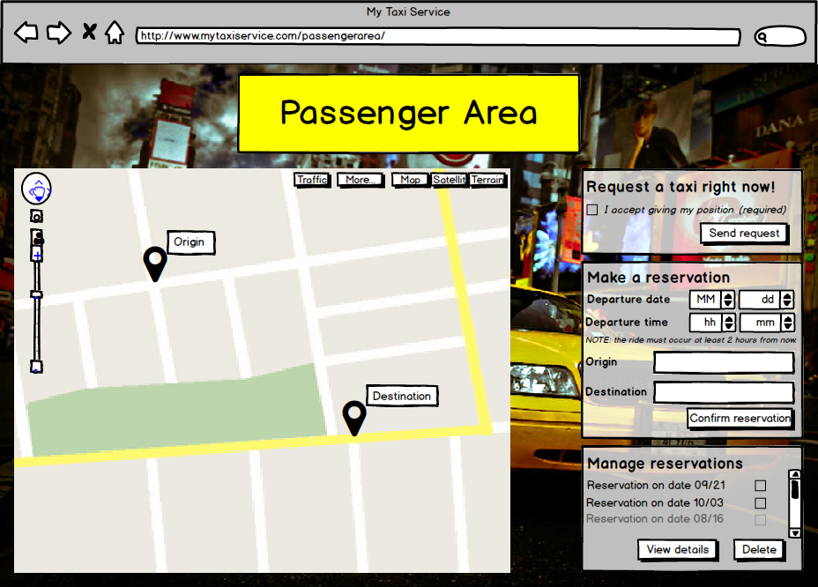
Mockup

Slide 10
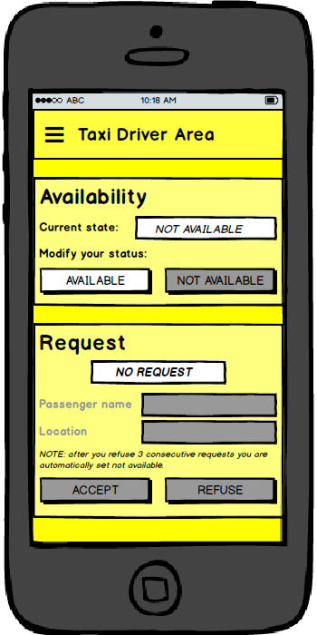
Mockup

Slide 11
API
For taxi waiting time and other minor features we decided to use Google
Maps API. It is a very powerful library that perfectly fits our needs. When
a taxi accepts a request, the system retrieves its position and, through those
APIs, is able to process either the hypothetical route that the taxi will follow
to reach the passenger’s position and, consequently, the arrival time. The
system will, then, forward those information to the passenger.

Slide 12
Functional Requirements
Permit a guest to register to the service
Registration form
Information verification
Permit a guest to sign in
Sign in form
Information verification
Permit a guest to request a taxi
Request form
Position
Permit a registered passenger to request a taxi
Position
Permit a registered passenger to make a reservation
Reservation form with origin and destination
Time constraint

Slide 13
Functional Requirements
Permit a registered passenger to cancel a reservation
Time constraint
Permit a taxi driver to give the system his availability
New status different from actual one
Permit a taxi driver to revoke his availability
New status different from actual on
Permit a taxi driver to accept a ride request
System removes taxi from the queue in order to submit request
Taxi set as unavailable
Permit a taxi driver to refuse a ride request
System removes taxi from the queue in order to submit request
System places the taxi again in queue in the last position

Slide 14
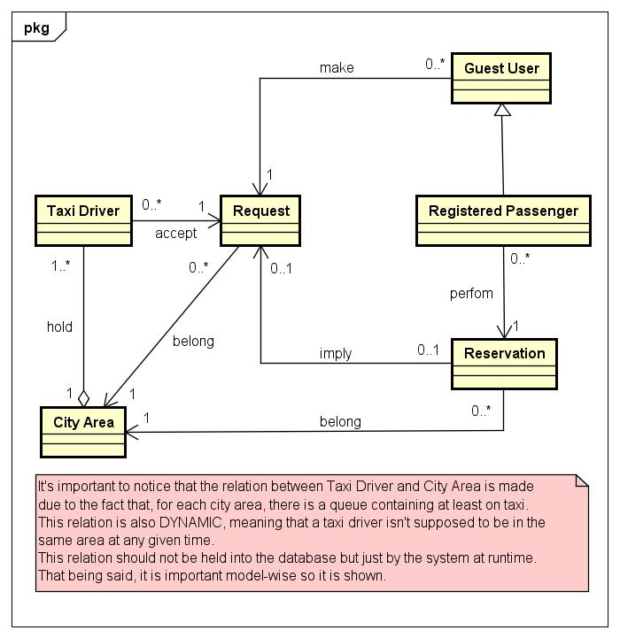
Class diagram

Slide 15
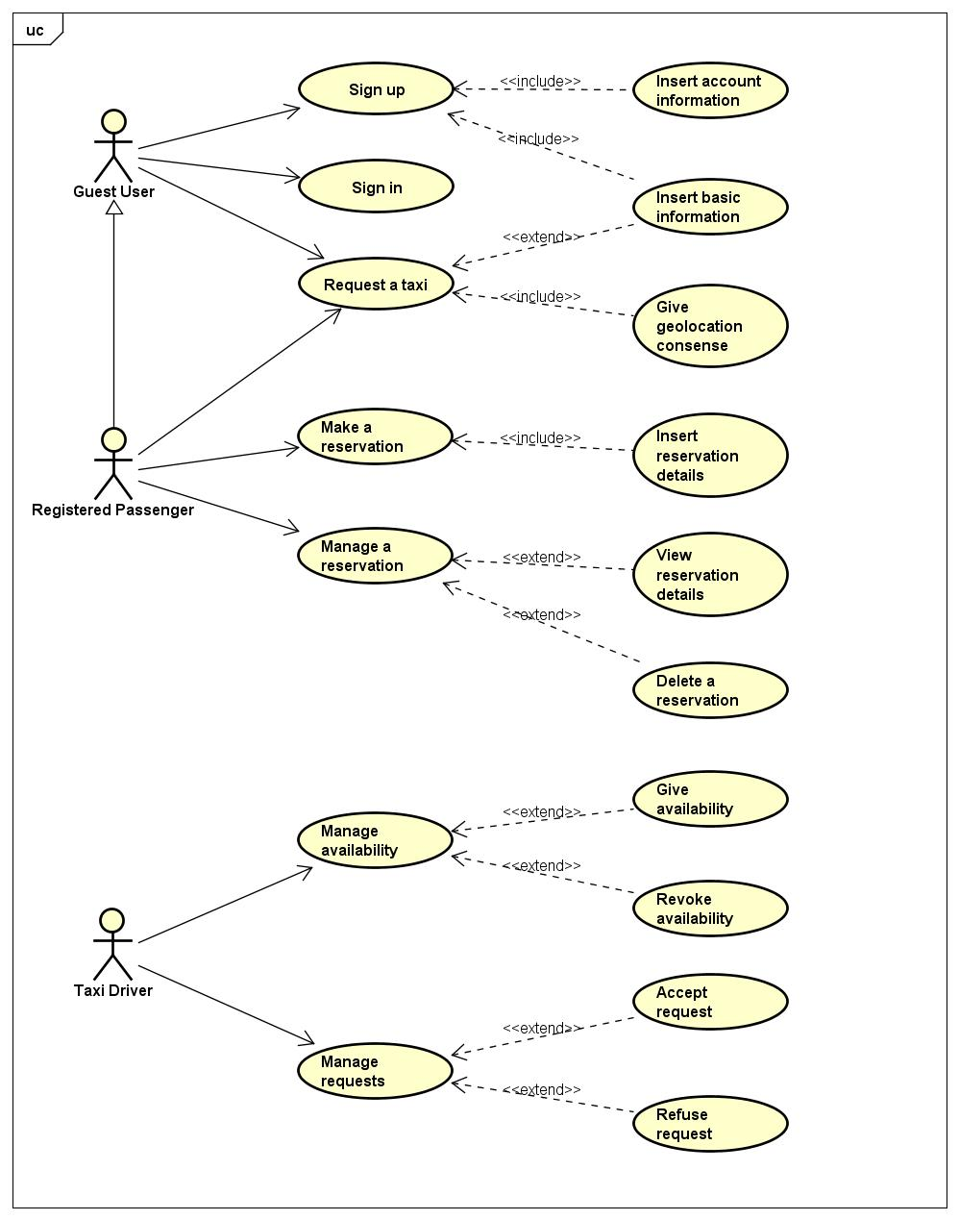
Use Case diagram

Slide 16
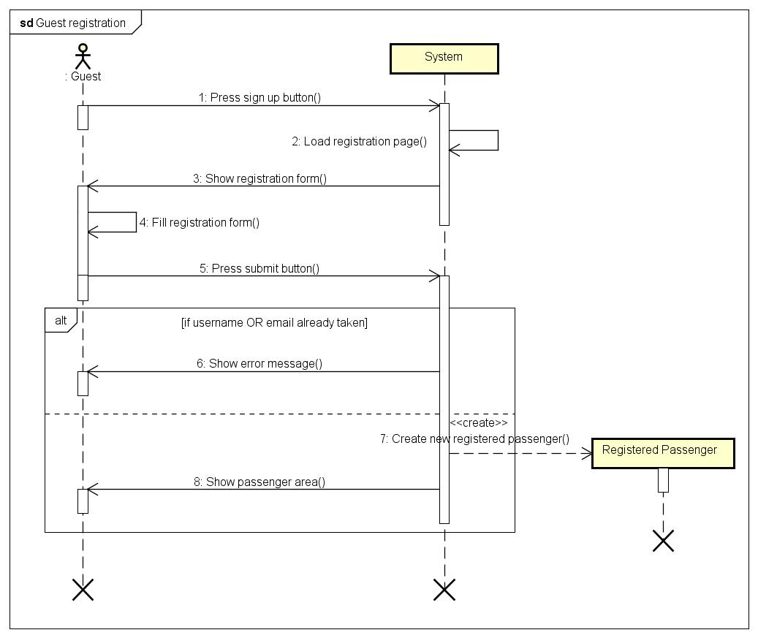
Sequence Diagram – Guest registration

Slide 17
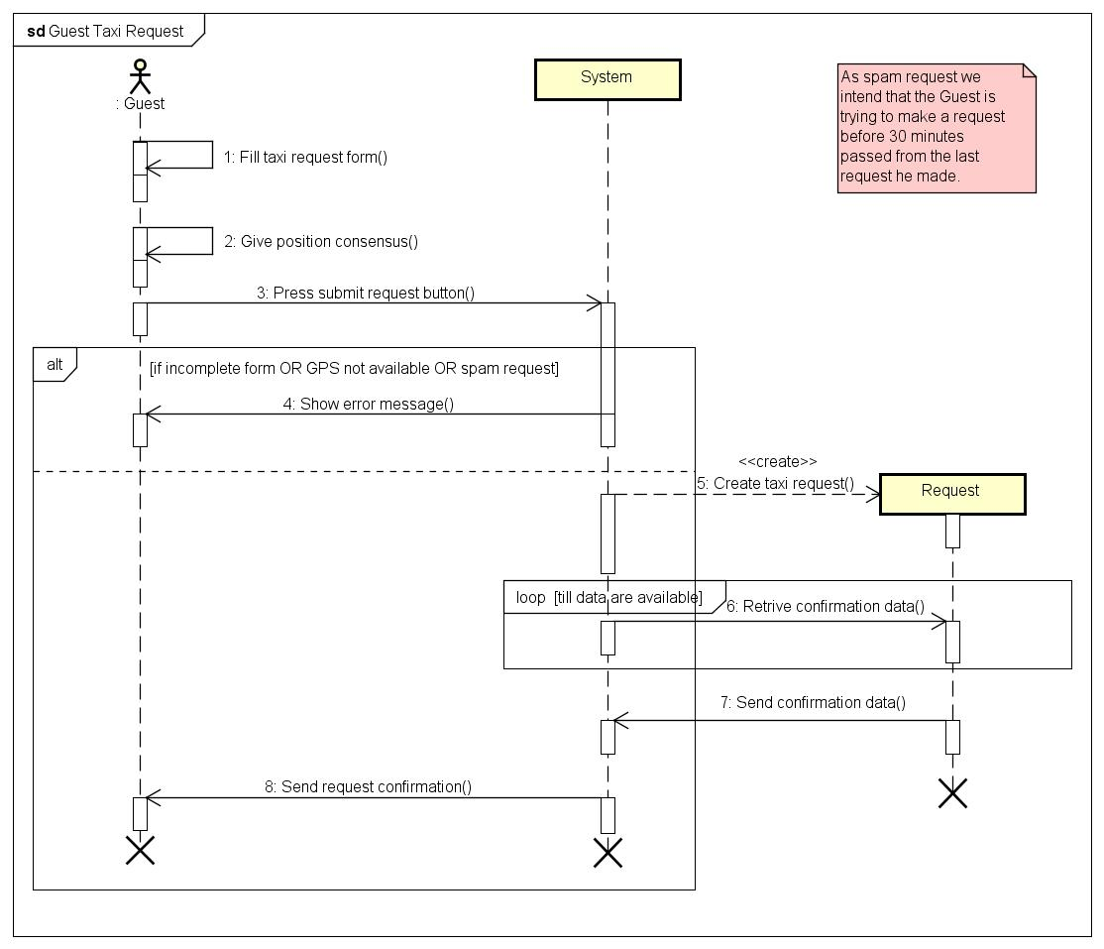
Sequence Diagram – Guest makes a taxi request

Slide 18
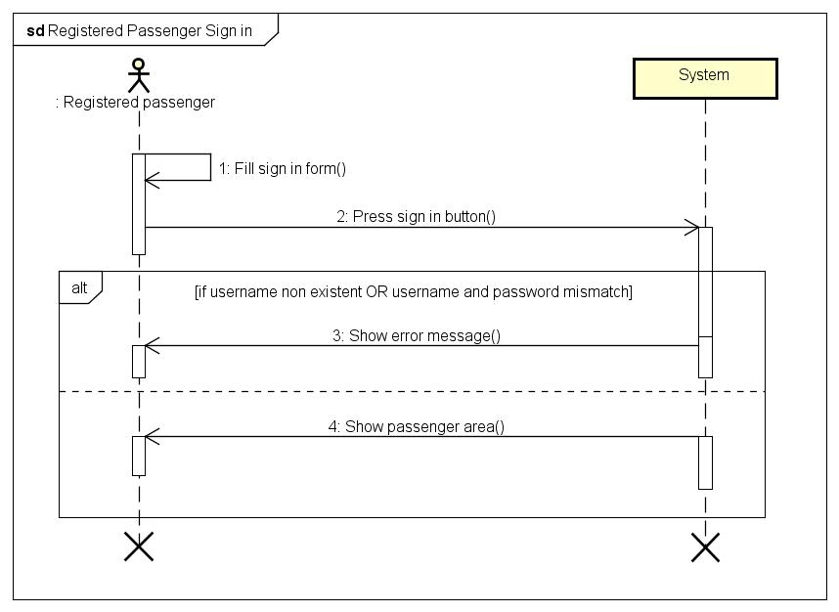
Sequence Diagram – Registered Passenger sign in

Slide 19
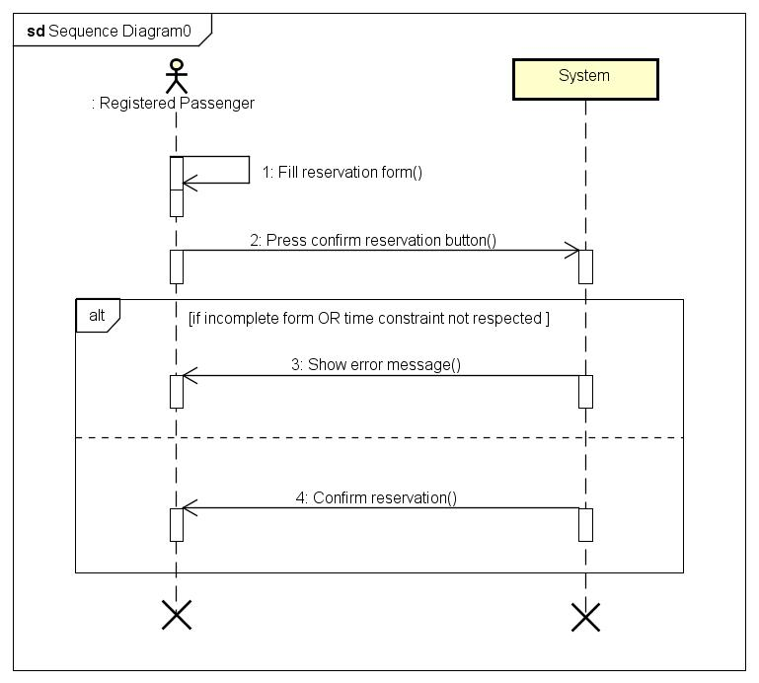
Sequence Diagram – Registered Passenger makes a reservation

Slide 20
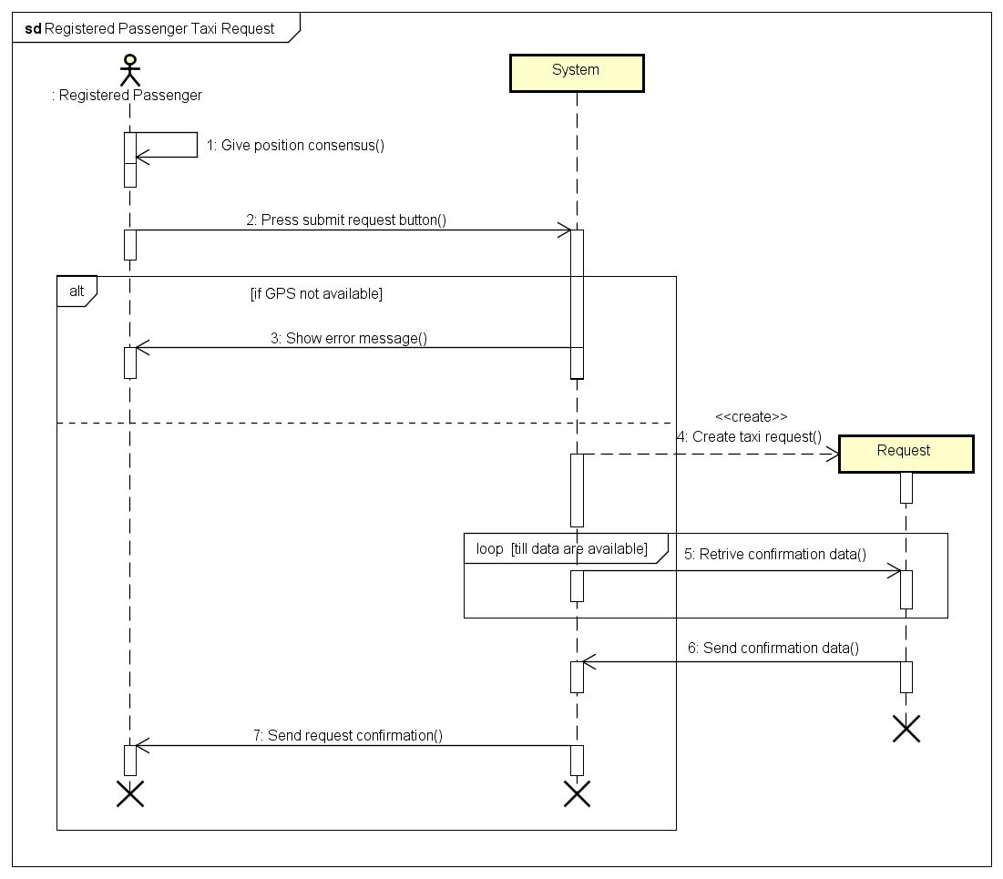
Sequence Diagram – Registered Passenger makes a taxi request

Slide 21
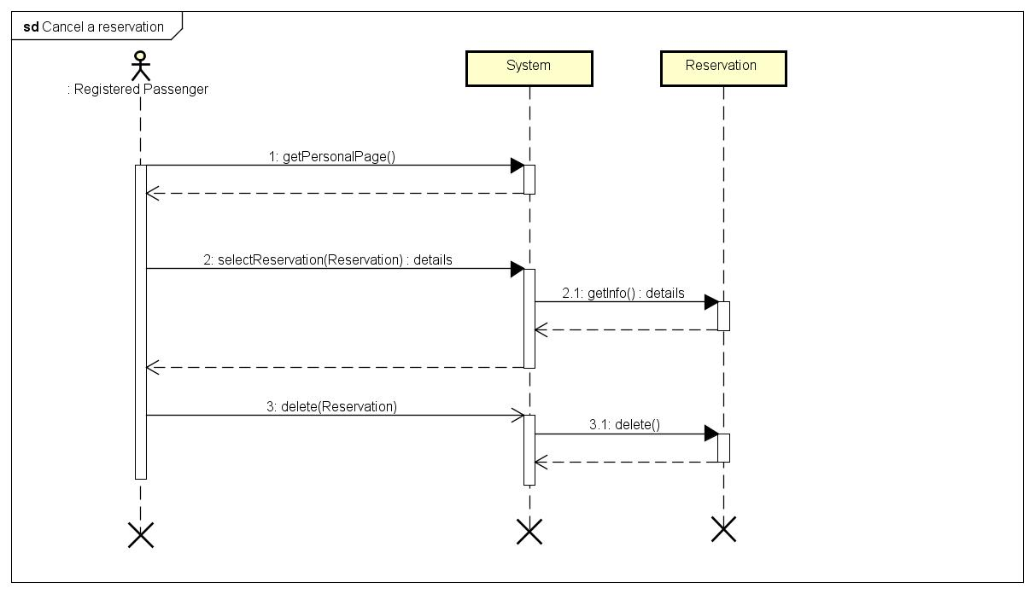
Sequence Diagram – Registered Passenger cancels a reservation

Slide 22
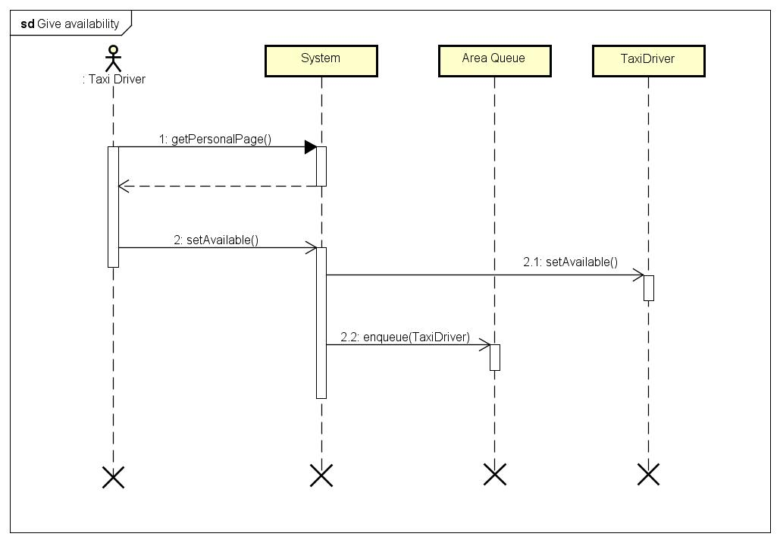
Sequence Diagram – Taxi Driver gives availability

Slide 23
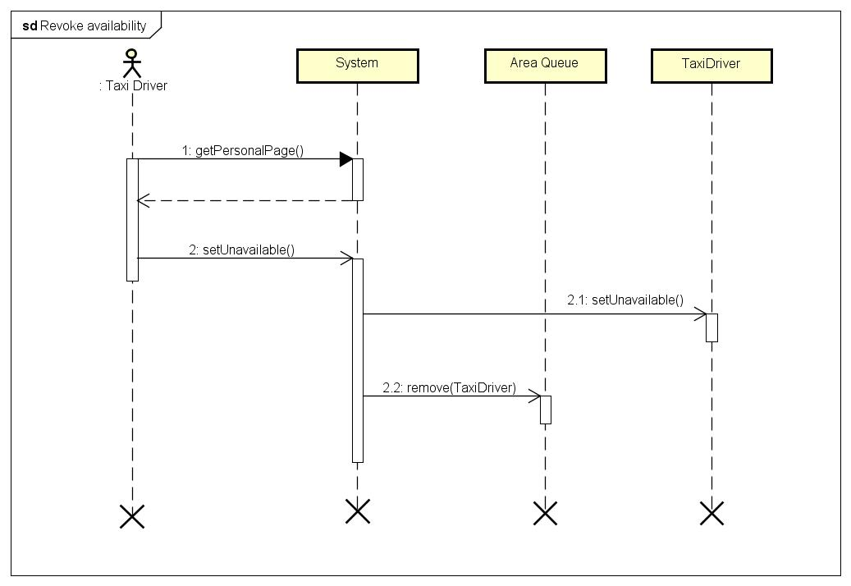
Sequence Diagram – Taxi Driver revokes availability

Slide 24
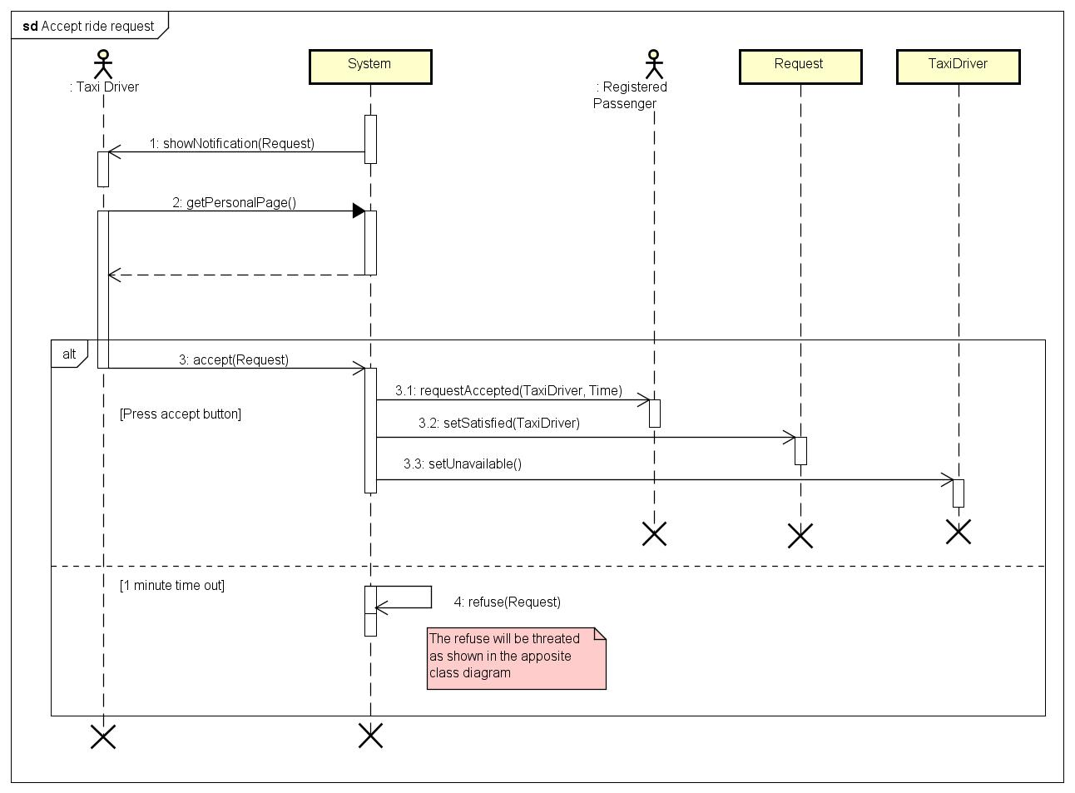
Sequence Diagram – Taxi Driver accepts a ride request

Slide 25
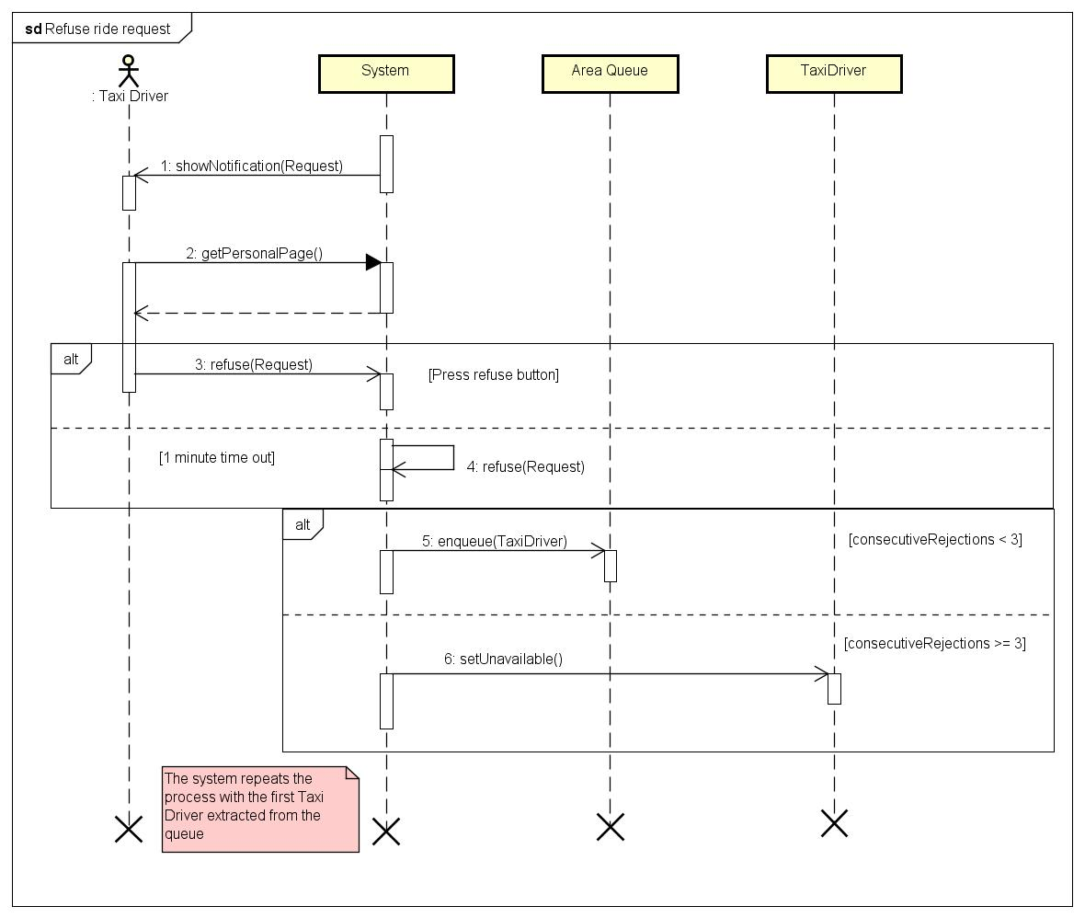
Sequence Diagram – Taxi Driver refuses a ride request

Slide 26
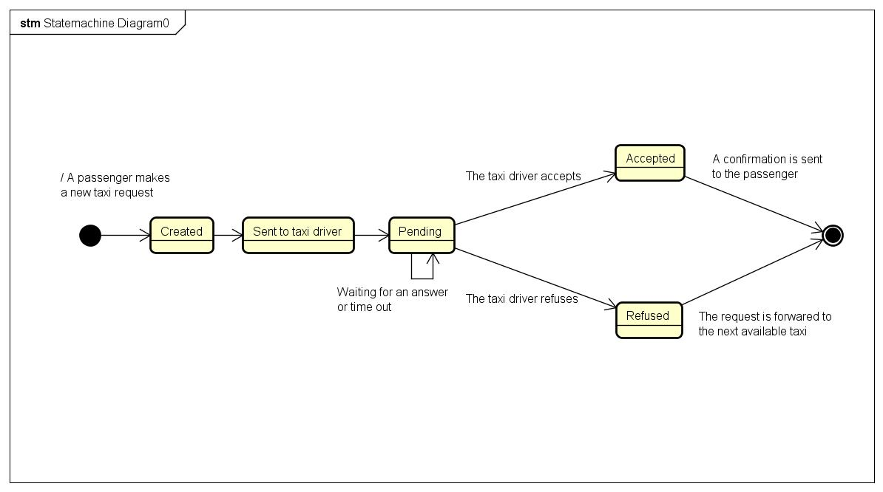
State Chart - Request

Slide 27
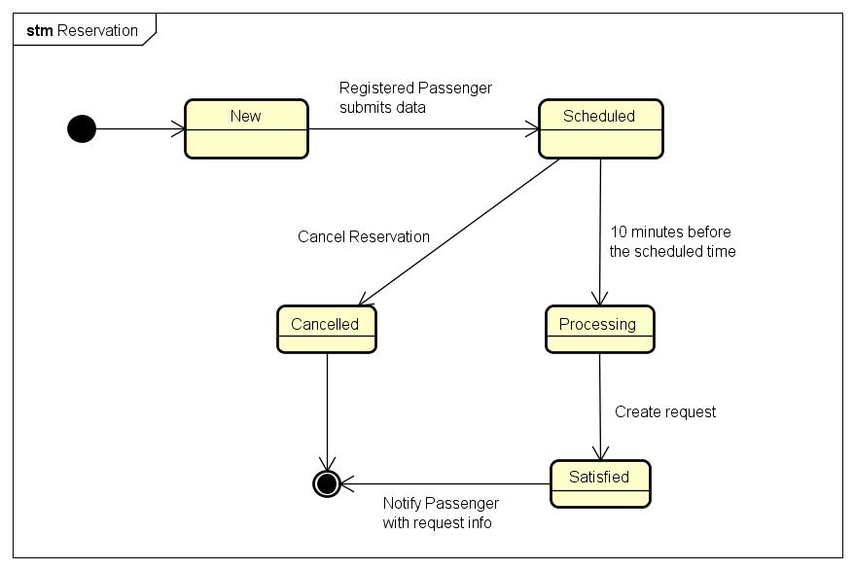
State Chart - Reservation

Slide 28
Non Functional Requirements
User friendliness
The user interface has to be simple and intuitive. This will help any kind of user to easily access our service.
Portability
The client has to be compatible to all the major hardware and software platform on the market.
Performance
In order to have a good service, the system has to be reactive and able to answer a high number of simultaneous requests. The interaction between the client and the server has to be reduced to a minimum, in order to prevent overload.
Availability
The service should be available to the user the highest possible amount of time. We suppose to be able to grant a 4-nines availability, which means a 52 minutes per years of downtime.
Data integrity and consistency
Data have to be always accessible, so the system has to provide an access to them in normal condition. Security
To ensure that sensible data remain private, the system should offer different security measures. The accounts are protected by the couple username-password. Data should be filtered in order to avoid vicious or unwanted modification in the data base (e.g. SQL injection). Finally, in order to protect the on-line transmission of data an HTTPS protocol could be used.

Slide 29
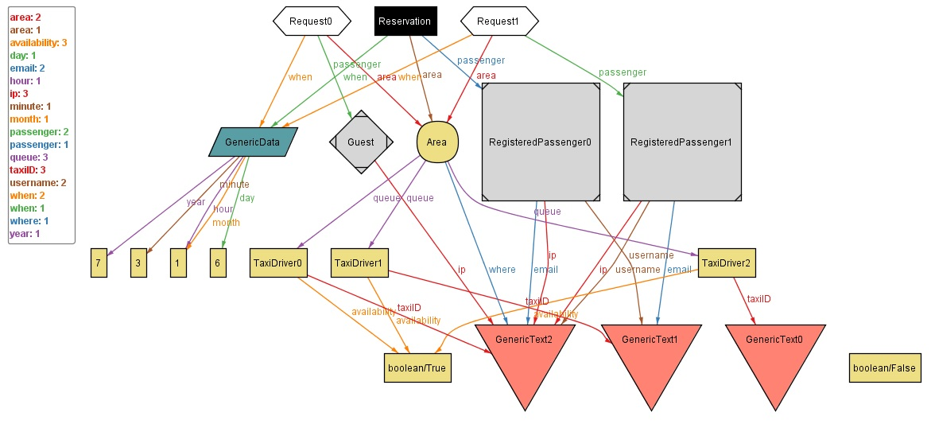
Alloy World – Casual Situation

